Slide 1
Nick Lutostanski
Intro to Neural Networks: AI/ML for Business Applications
4/5/2024

Slide 2
Contents / Agenda
Executive Summary
Business Problem Overview and Solution Approach
EDA Results
Data Preprocessing
Model Performance Summary
Appendix

Slide 3
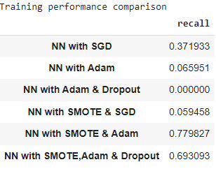
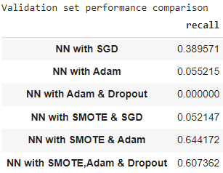
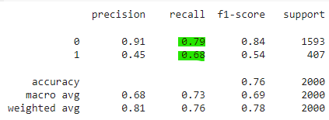
Executive Summary
The goal of the project was to build 6 different neural networks using different methods of class balancing, weight optimizers, a the dropout method and see which would work better. Our results are below:
Based on these scores, we would recommend deployment of the Neural network with Smote class balancing and the Adam optimizer for weights to predict which customers will churn and which will not.
It produced the highest recall score among training/validation and then as well on unseen testing data. Further tinkering with hyperparameters – adding more nodes per player, or an additional layer, might be recommended to finer tune performance.
We can then run this network on unseen test data and target those that we believe will churn in the next 6 months with special promotions or incentives to stay with the bank.

Slide 4
Business Problem Overview and Solution Approach
Businesses like banks that provide service have to worry about the problem of 'Customer Churn' i.e. customers leaving and joining another service provider. It is important to understand which aspects of the service influence a customer's decision in this regard. Management can concentrate efforts on the improvement of service, keeping in mind these priorities.
You as a Data scientist with the bank need to build a neural network-based classifier that can determine whether a customer will leave the bank or not in the next 6 months.
We will build a neural network that will predict if a customer is likely to churn in the next 6 months starting with a SGD as an optimizer. We will then try and improve the model by using Adam as an optimizer, Adam with the dropout technique. After building these 3 networks, we will balance the sample data using SMOTE (to oversample the minority class) and build them all again to see the potential performance improvements.

Slide 5
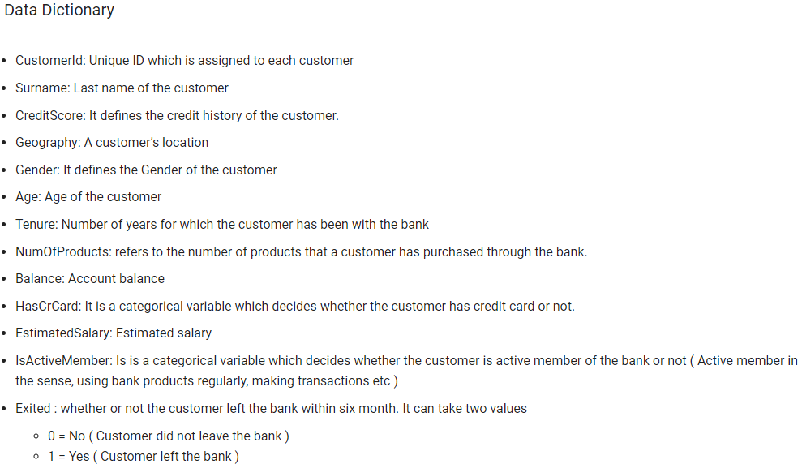
Business Problem Overview - Dataset Information

Slide 6
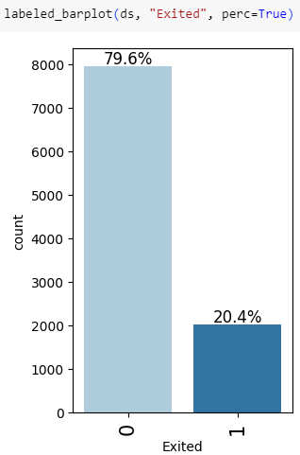
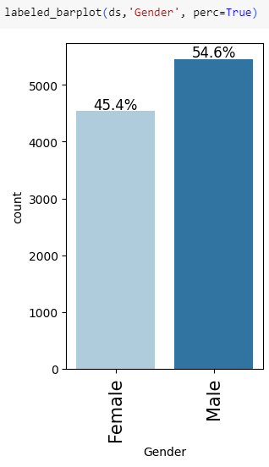
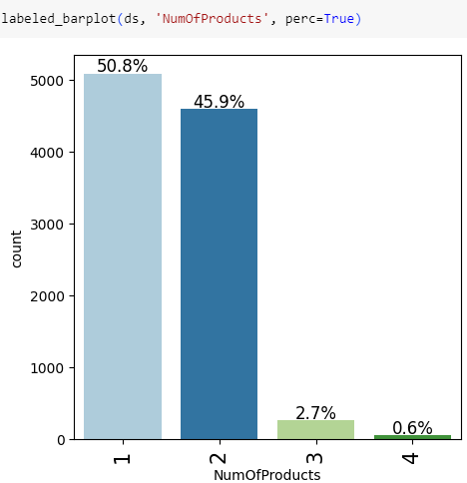
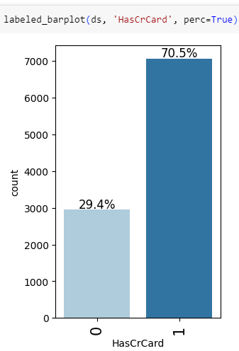
EDA Results – Univariate Analysis
In the data set, 79.6% of customers did not churn while 20.4% did. The data set is imbalanced for our target variable. We will balance this using SMOTE in 3 of our 6 NN.
The data set is roughly balanced by gender, with slightly more males
A large majority of customers only have 1-2 products from the bank. A very small percentage have 3+
70.5% of customers in the data set had credit cards.

Slide 7
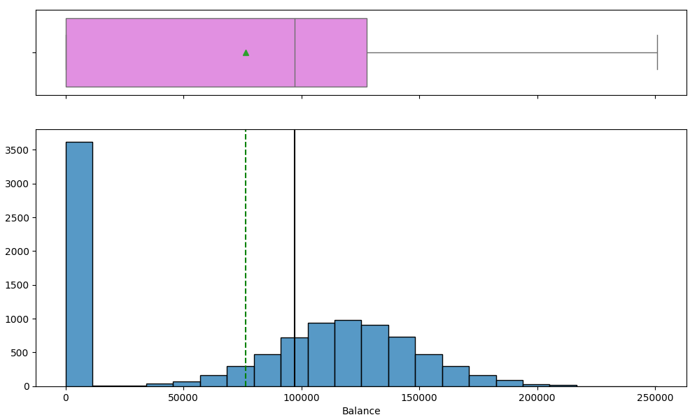
EDA Results – Univariate Analysis - Balance
The balance almost looks normally distributed if it weren’t for the very high number of members that have a zero or very small balance close to zero, as seen on the right-most bin in the histogram.

Slide 8
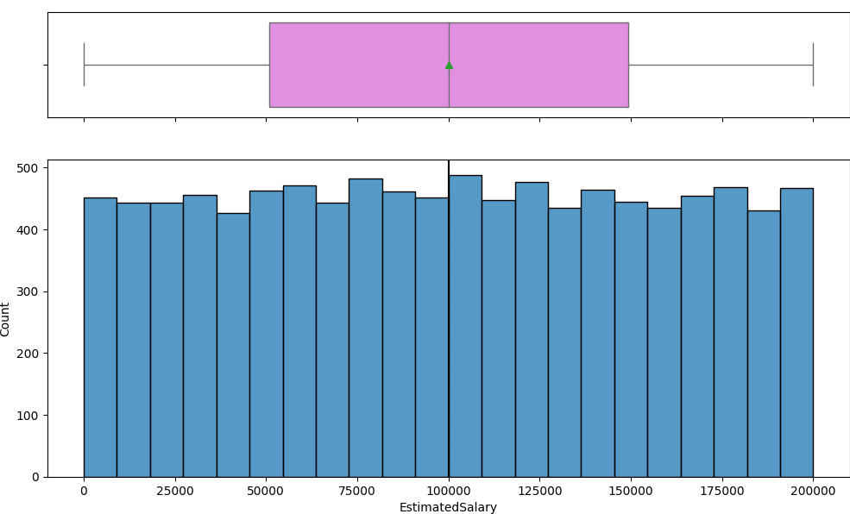
EDA Results – Univariate Analysis – Estimated Salary
There is a fairly even distribution among estimated salary range.

Slide 9
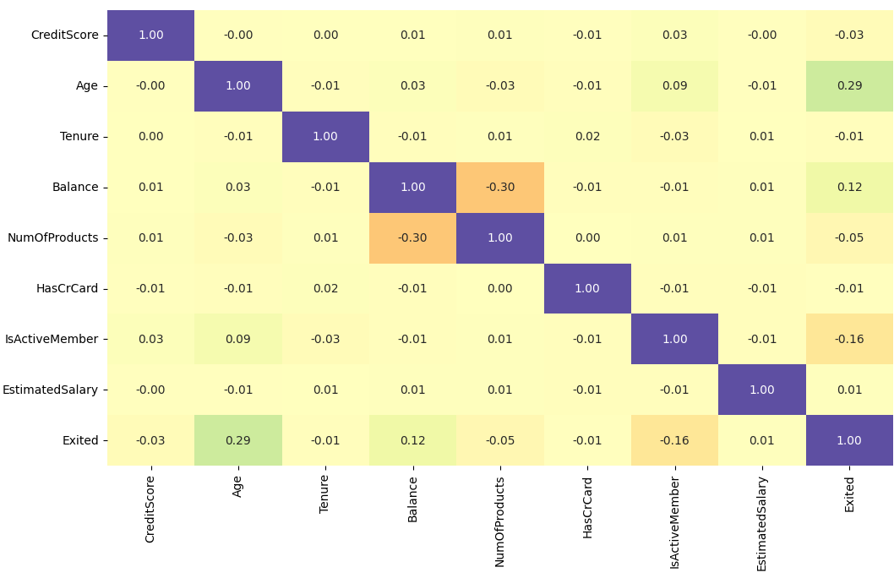
EDA Results – Bivariate Analysis - Heatmap
Examining the correlation heatmap, we can see that account balance and number of products are slightly negatively correlated and Age seems to be the most positively correlated value relating to the target variable Exited.

Slide 10
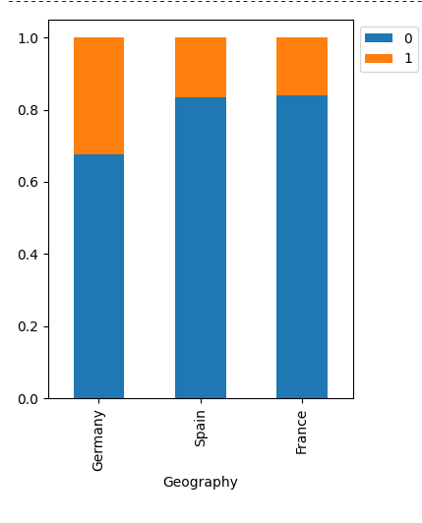
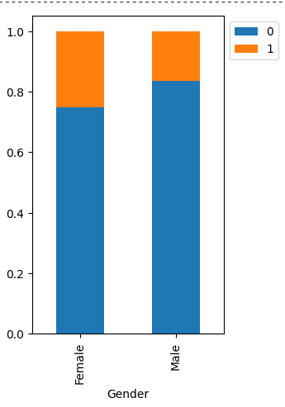
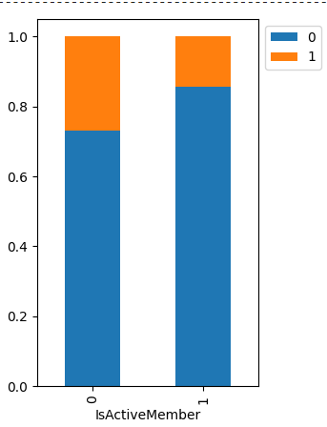
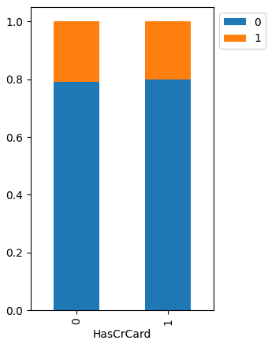
EDA Results – Bivariate Analysis – Geog, Gender,
While we can observe slight difference between the categorical variables, it seems like roughly equal distributions between churners and non-churners when you look at Geography, Gender, if they are active members, or if they have a credit card or not.

Slide 11
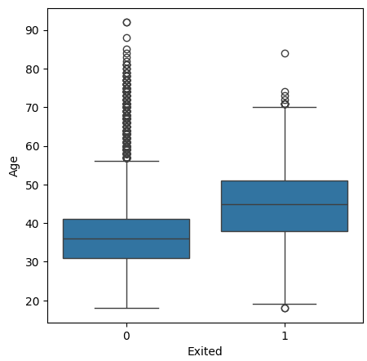
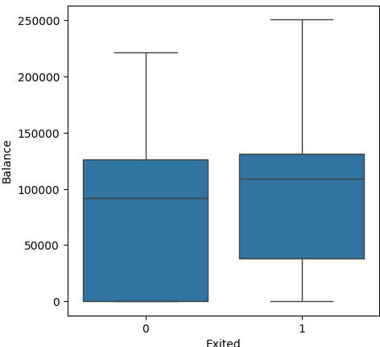
EDA Results – Bivariate Analysis – Age & Balance
As we noted while looking at the heatmap, there is a fairly large difference in distribution of churners versus non churners in age. The median age to churn is about 10 years higher, on average, than those that do not churn, but there are a large number of older outliers among the non-churners as well.
Interestingly, those with lower balances were more likely not to churn compared to those with higher balances.

Slide 12
Data Preprocessing
We observed that there were no duplicate values or missing values.
While there are a large number of outliers in age, this is valuable data that we need to capture for our analysis so we do not treat.
We encoded Geography and Gender column so that we can use it in the neural network.
Of the 10,000 rows in the data set, we used 20% for the test set, 64% for the training set, and 16% for the validation set.
For all neural networks, we chose epochs at 50 and a batch size of 6400 (which is equal to the size of the test set) since computational efficiency isn’t an issue with such a small dataset.
We used StandardScaler() on CreditScore, Age, Tenure, Balance, And Estimated Salary range variables to normalize the distributions.
For this business scenario, like other churning problems, we would like to use the recall metric to judge a neural networks performance since we would like to minimize false negatives, which in this case would be predicting that a customer will NOT churn, when they actually would.

Slide 13
Model Performance Summary
For all networks, we used the full 6400 test set as the batch_size and 50 epochs. We used sigmoid activation function for all output layers and ReLU activation functions for all hidden layers. When dropout technique is used, we specified .5 value. Our goal was to maximize the recall for performance to minimize misclassifying actual churners as non-churners.
Based on the results that we saw, it appears that NN with SMOTE & Adam optimizer had the best performance on both the training set and the Validation set. So it would be the best to use among those that we built. Fitting this to the test set produces a .68 recall score.

Slide 14
APPENDIX

Slide 15
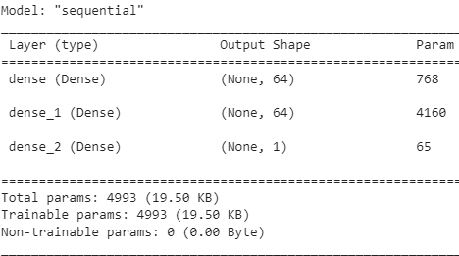
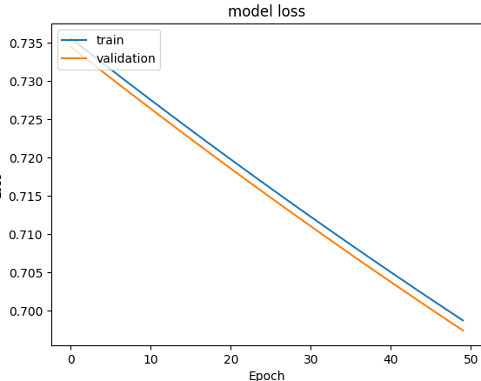
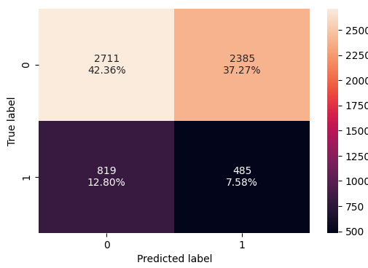
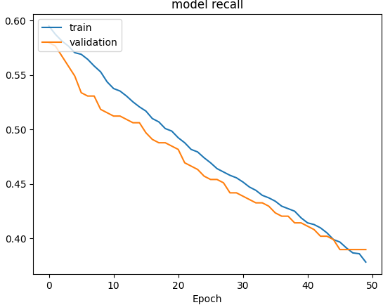
Neural Network with Stochastic Gradient Descent (SGD)

Slide 16
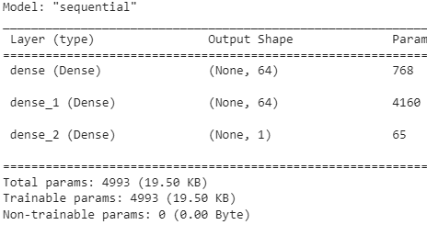
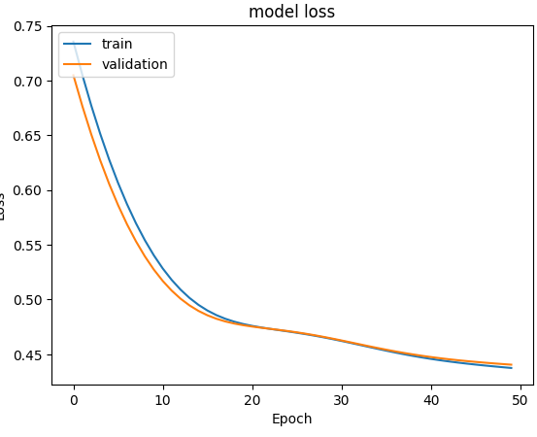
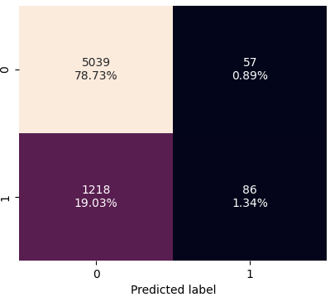
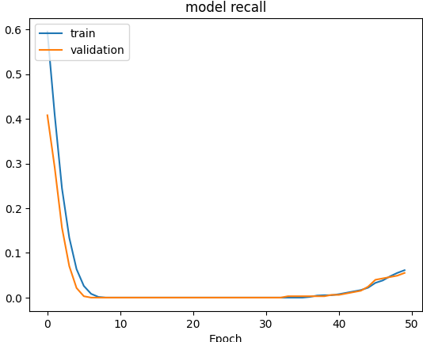
Neural Network with Adam Optimizer

Slide 17
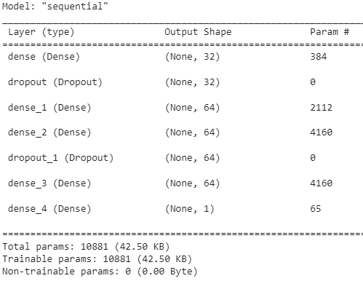
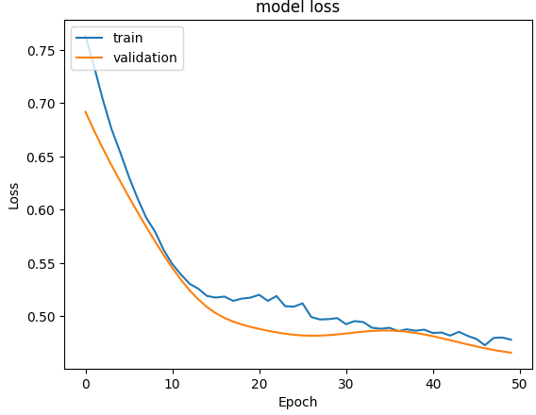
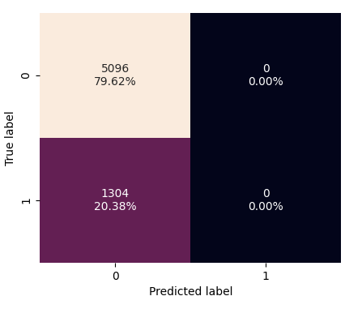
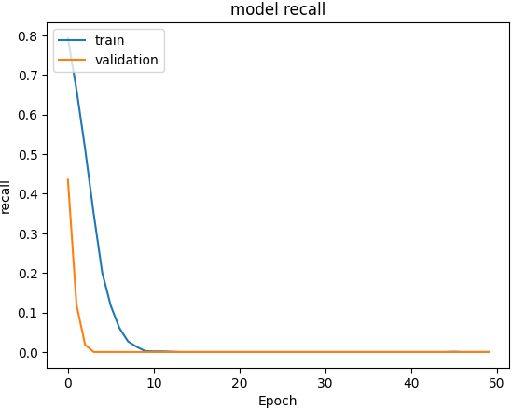
Neural Network with Adam Optimizer & Dropout (.5)

Slide 18
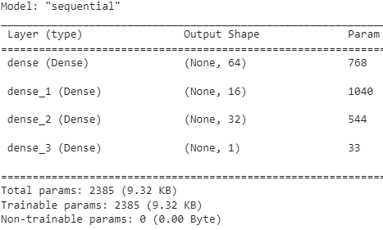
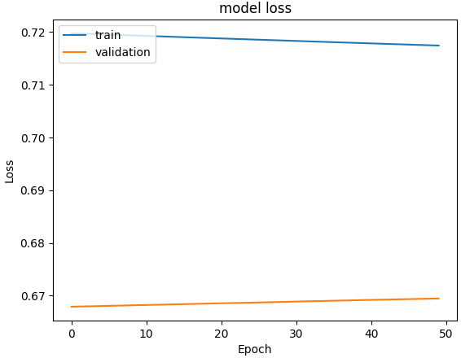
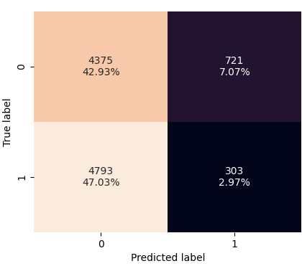
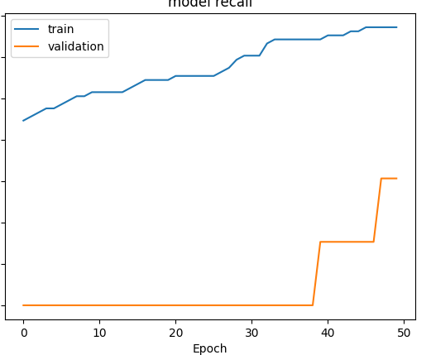
Neural Network with SMOTE balanced data & SGD

Slide 19
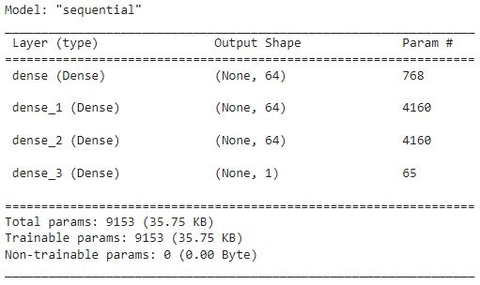
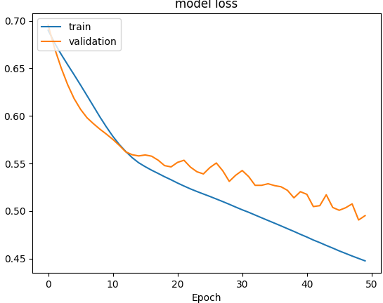
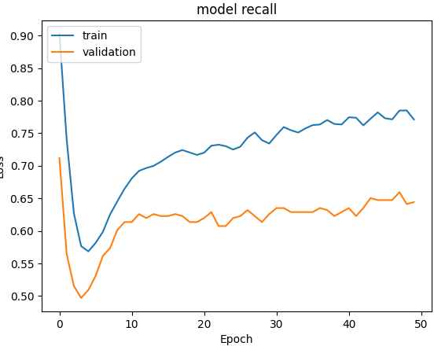
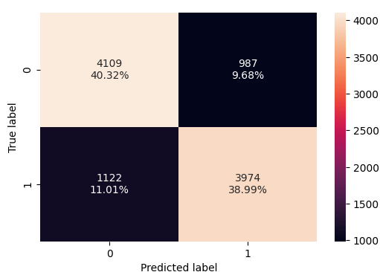
Neural Network with SMOTE balanced data & Adam optimizer

Slide 20
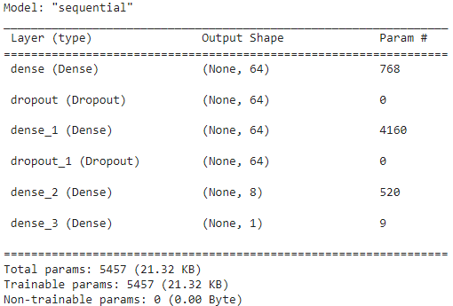
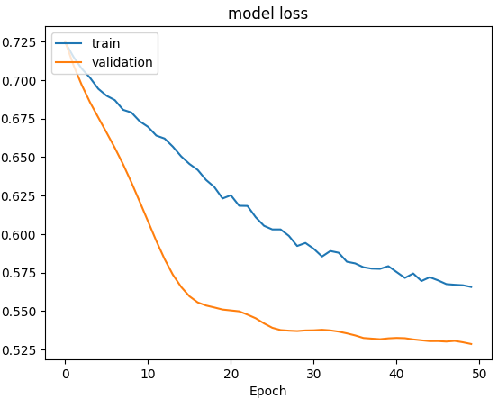
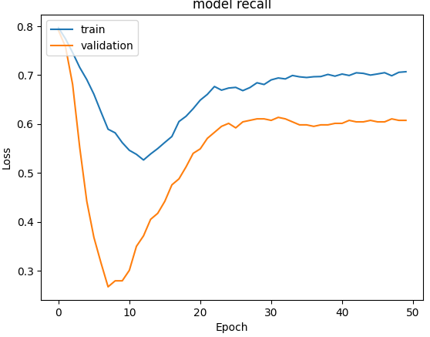
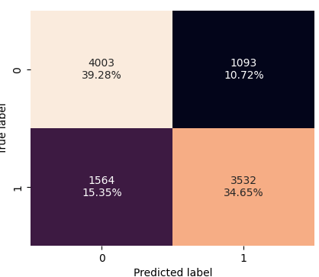
Neural Network with SMOTE & Adam w/ dropout (.5)

